Slide 1
Is it real ?
In Japan, if we swim in the sea, ghost take us into the sea.
Space Apps Challenge Kushimoto 2020
team name : RiGanRyu
Taniguchi,Koyama,Ito,Niki,Hatashita

Slide 2
1. Are most accidents while swimming in the ocean caused by rip currents?
Hypothesis
'Away-from-shore currents are a pretty dangerous phenomenon, not just for the Bon holidays.'
Supporting data
1. Number of water-related accidents and fatalities in Japan 2. the number of lifesavers on the ground and Proportion of breakaway flows among the causes
Notes:
【課題：重要】

Slide 3
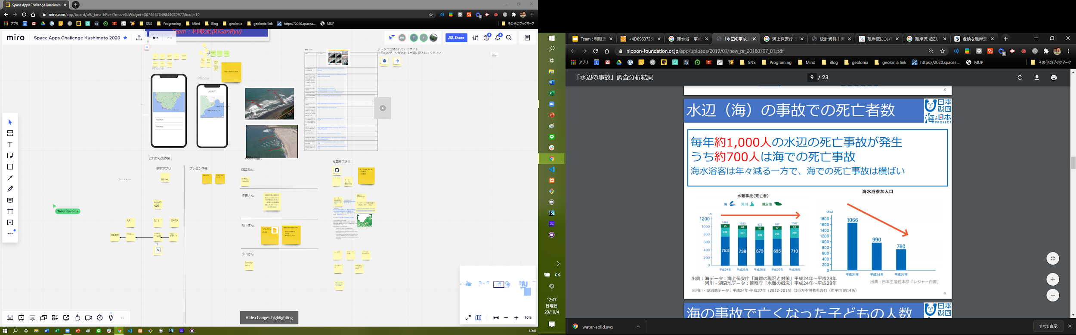
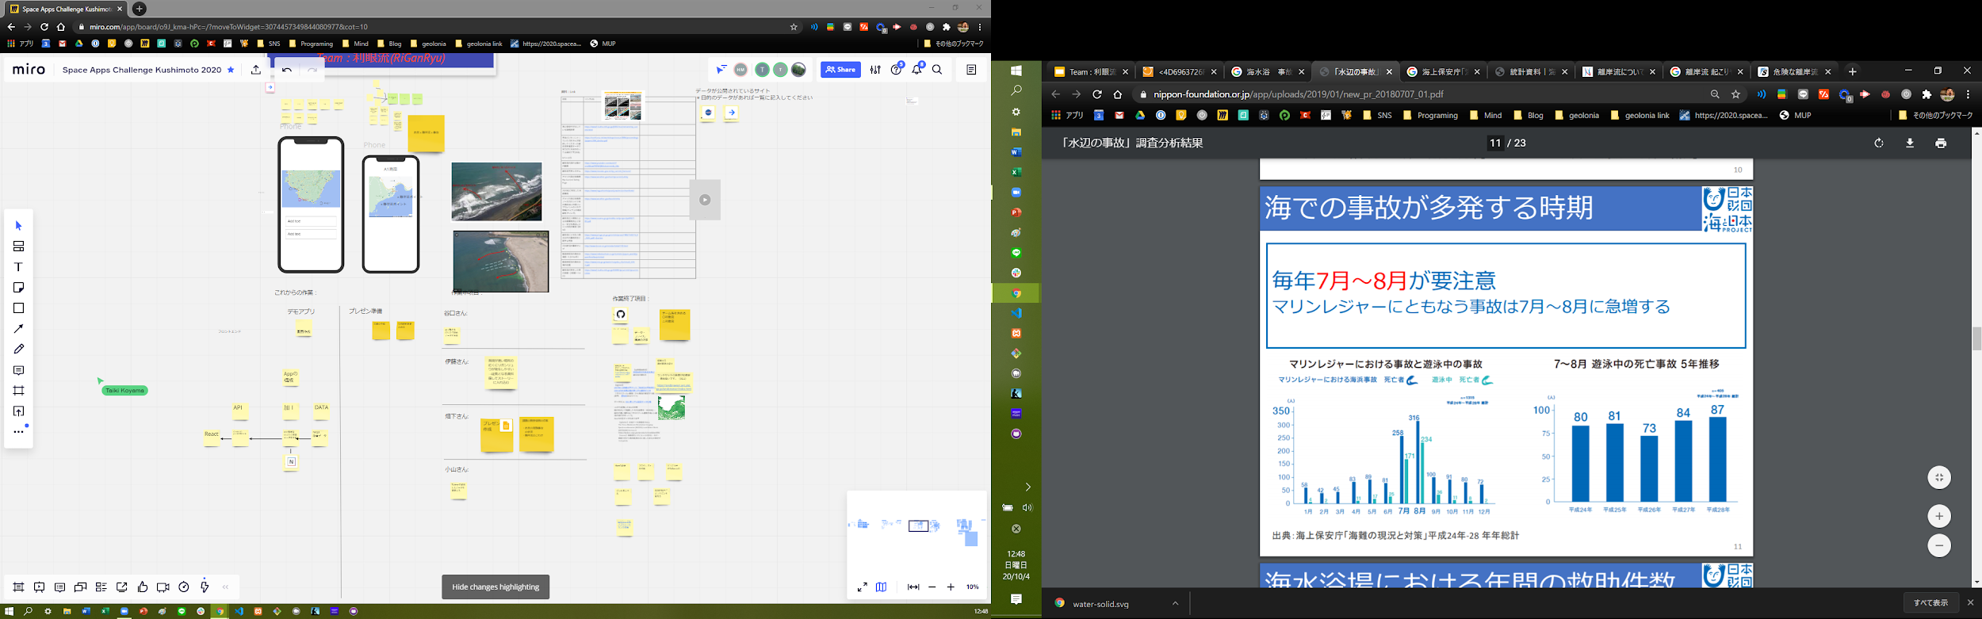
2. Are most accidents while swimming in the ocean caused by rip currents?
Data 1: Number of water-related accidents and fatalities in Japan

Slide 4
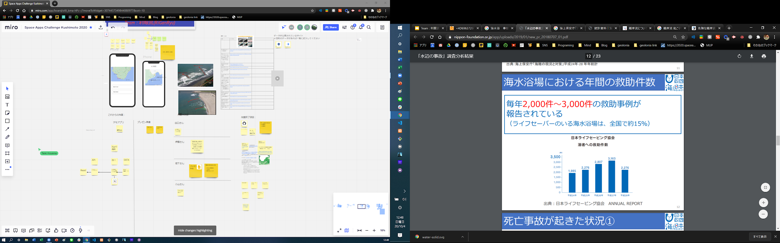
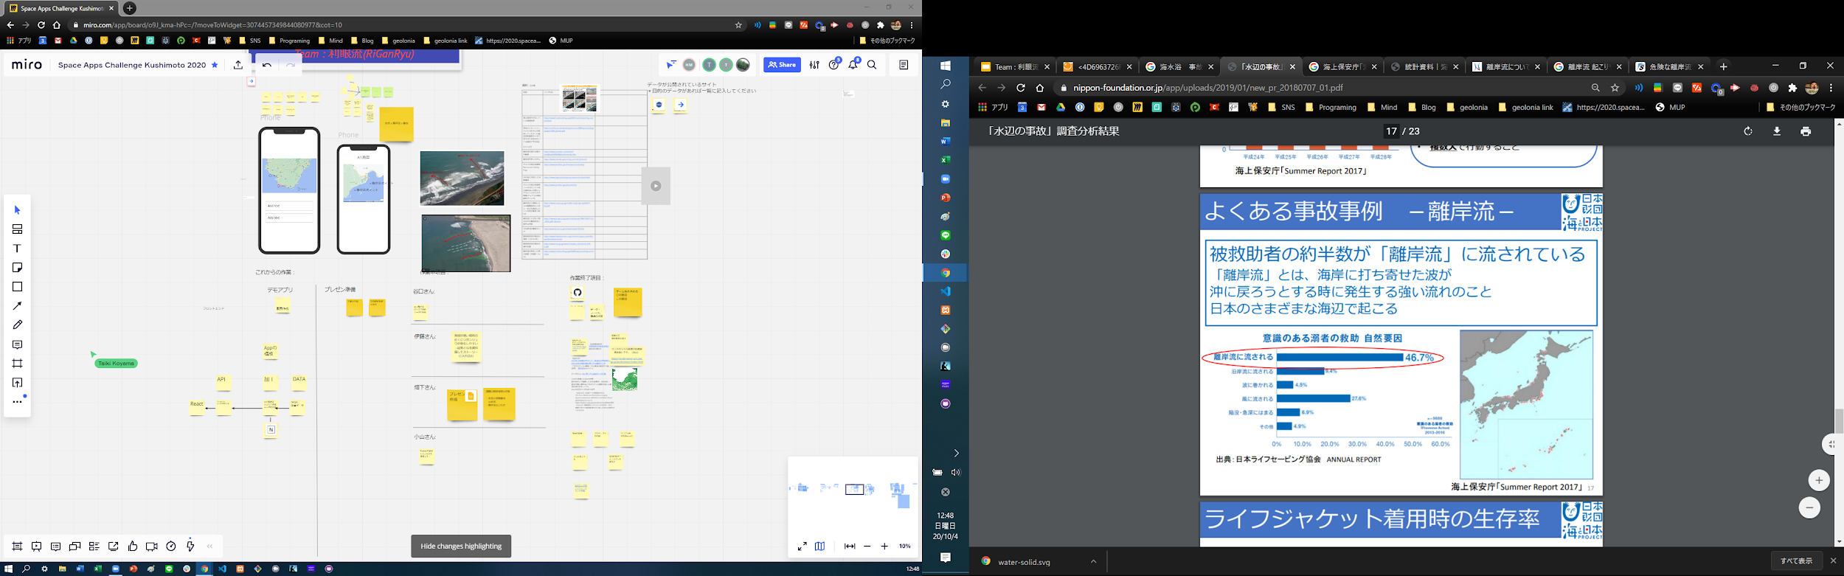
2. Are most accidents while swimming in the ocean caused by rip currents?
Data 2: Number of lifesaver rescues and the percentage of cases attributed to off-shore currents

Slide 5
3. Our app will be solved these.
Target
A swimmer in the sea
People who are concerned about the dangers.
What can be solved.
You can learn about the dangers in advance.
Remove psychological anxiety.
Function
Map out the breakaway currents that have occurred in the last 24 hours
I can find out the social networking information corresponding to that location.

Slide 6
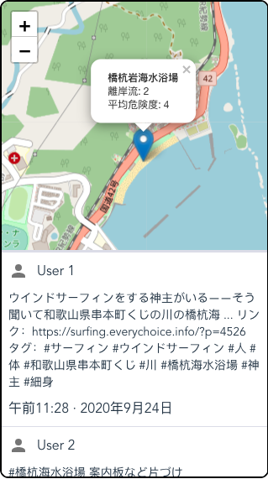
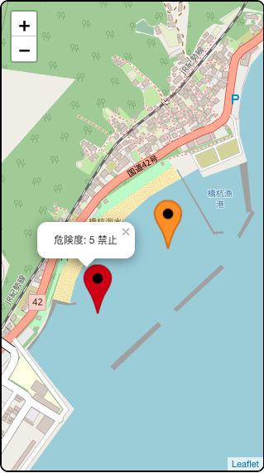
Frontend
Beach Info:
name
the number of rip currents
the average risk of the rip currents
As it shrinks in size, rep currents info can be seen with the below risk levels.
Very Low
Low
Medium
High
Very High
Tweets:
In this section, users can see tweets about beaches.

Slide 7
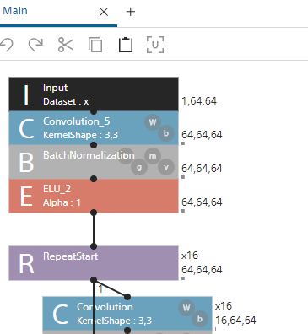
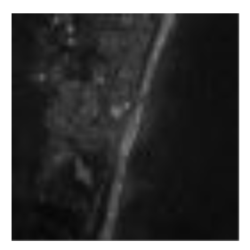
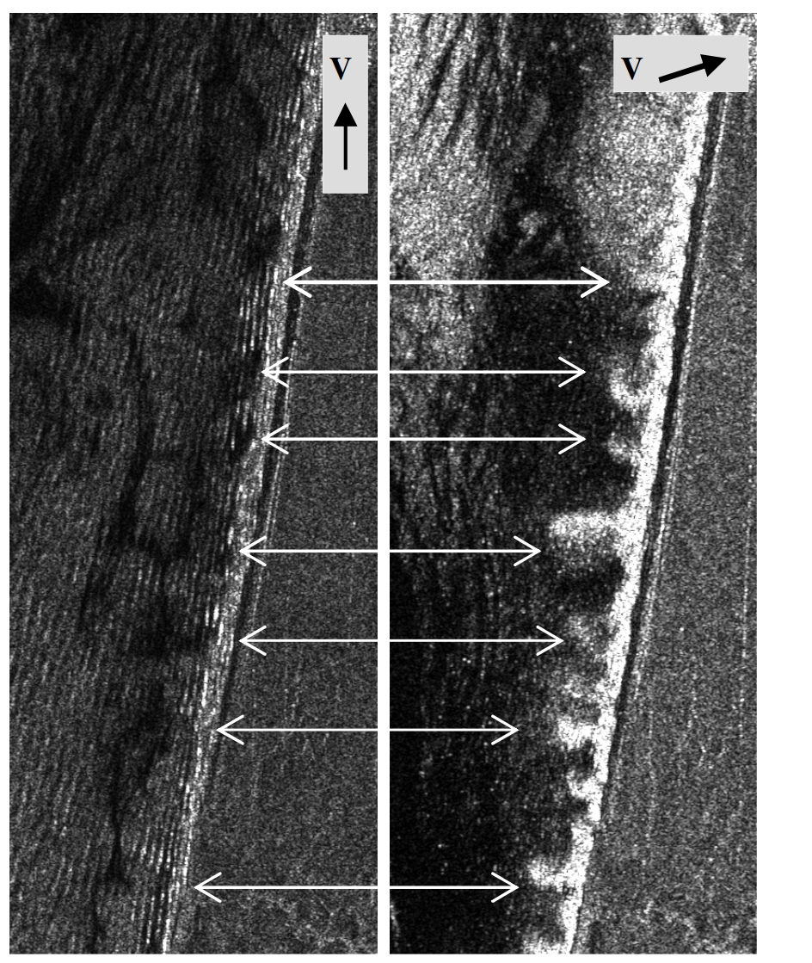
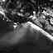
Backend
APP
json
Specific beaches.
Decidedly, the range of that range.
Collecting Images
ML determines a rip currents and the danger level.
Learning with coastal data showing the characteristics of the off-shore currents (sand flowing out to sea)
When a rip current occurs, a tooth pattern develops. 。
Ref: OBSERVATION OF RIP CURRENTS BY SYNTHETIC APERTURE RADAR

